Slide 1


TankMaster.net

Slide 2
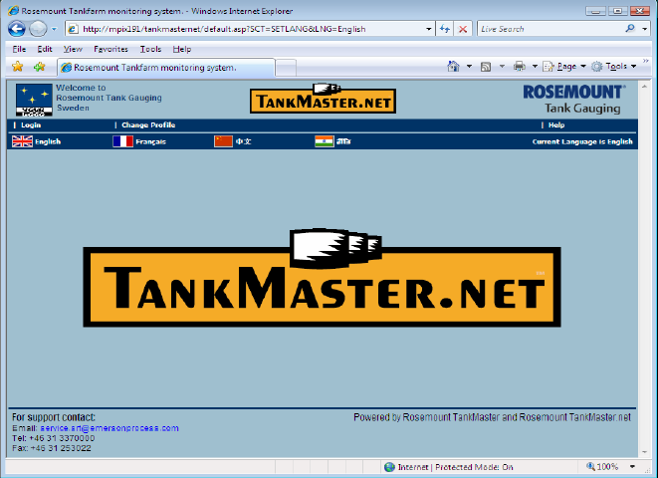
TankMaster.Net
TankMaster inventory info on a web server
Easy read out on any standard
Web browser on any PC
For Intranet
Locally “inside” the company
For Internet
External access
Customers
No need for installation of programs on remote PC’s
Demo site: www.tankmaster.net
Log in
User: Demo
PW: Demo

Slide 3
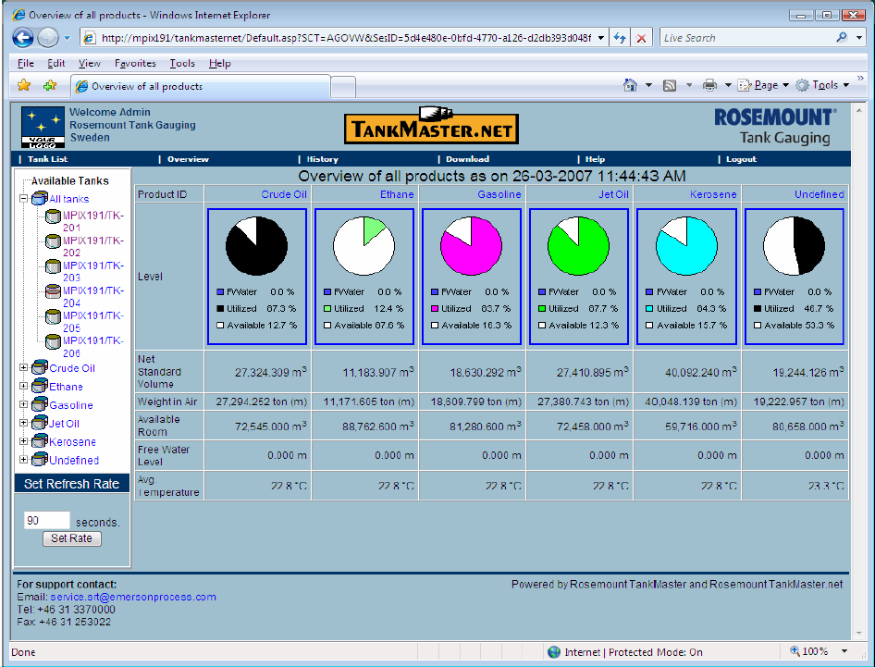
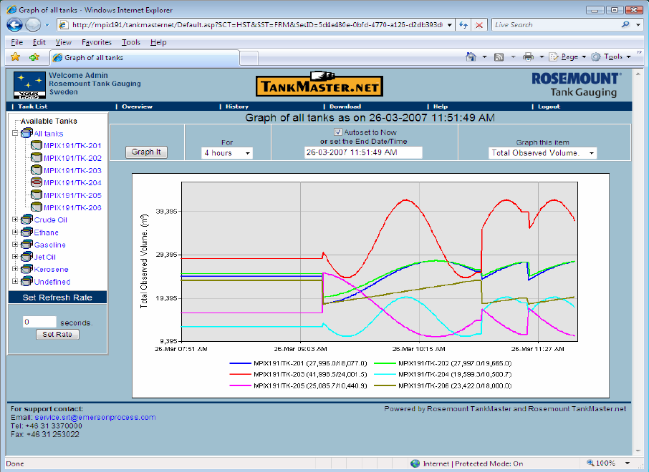
TankMaster.Net
Tank overview
Group summary for easy product overview
Report generator via MS Excel
Historical data views

Slide 4
TankMaster.Net
Easy to install
Defining users and tank areas.
Possibility to map different users to “their own” tanks.
User friendly
Easy handling and viewing inventory and product summary
Good online help.
Report printing online with actual data.
Historical views.

Slide 5
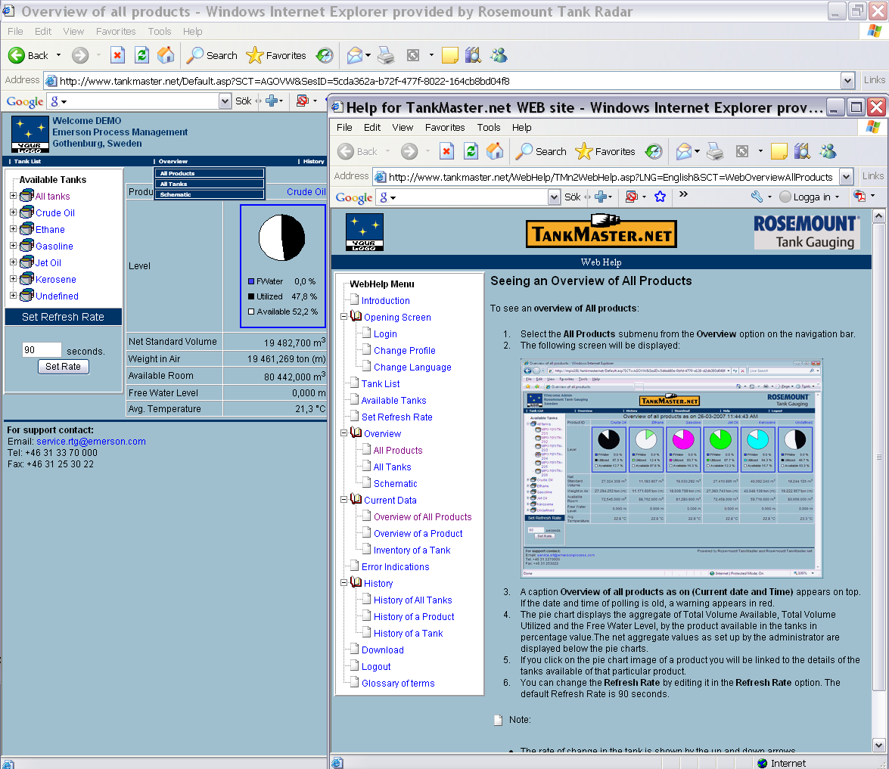

Slide 6
How to build
TM.Net - Internet
Min 256 kb/s
TM server – TM.Net server
Min 20 kb/s
per tank
TM – TM.Net
Can be installed in
the same PC

Slide 7
How to build
WAN
Internet
Explorer
Client
WWW
Client
TankMaster
TM
.
Net
TankMaster
Server
Server
Server
TM.Net
Can be connected to
Several TM servers

Slide 8
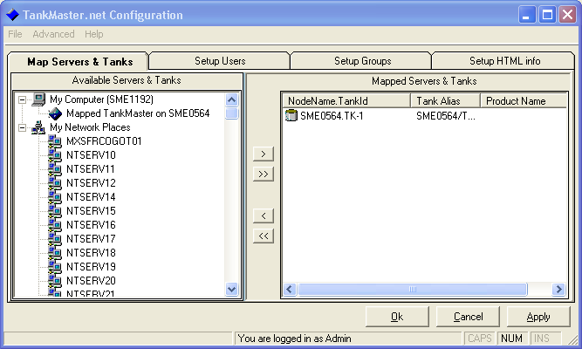
TMN Config
Setup of TankMaster net and the Web Page.
Mapping TM Servers.
Configuration of Users and Groups.
Linking Users to groups.

Slide 9
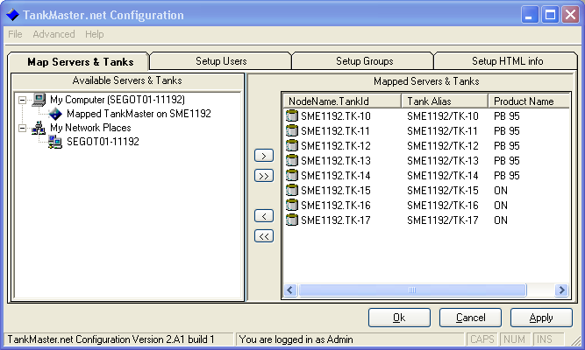
TMN Config
Map Servers & Tanks
Connection to tank servers
Map tanks from different tank servers
Products, Min and Max volumes, colours, and more…

Slide 10
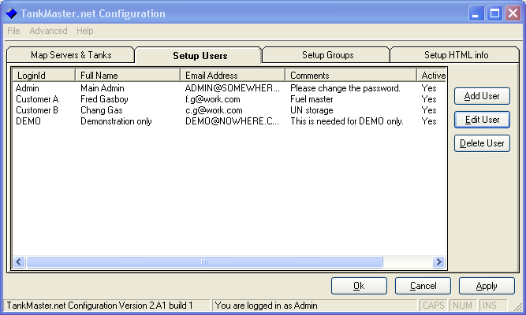
TMN Config
Setup Users
Create/edit access accounts to website
Specify username, password etc.
Enable/Disable accounts

Slide 11
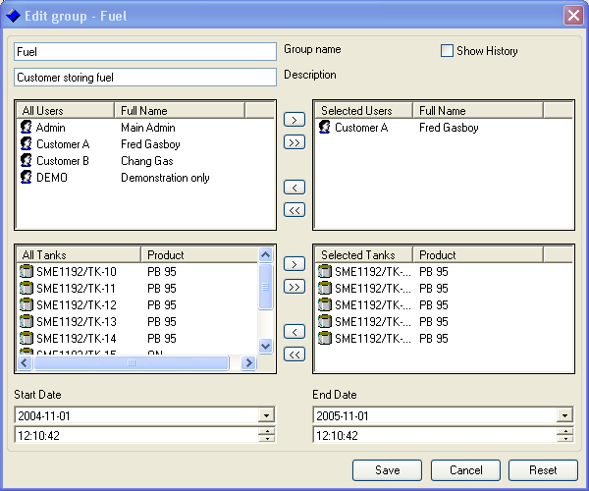
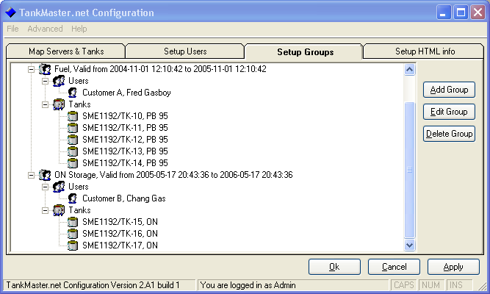
TMN Config
Setup Groups
Selecting tank access for users
Different users can get access to different tanks
Specify validity time for a group

Slide 12
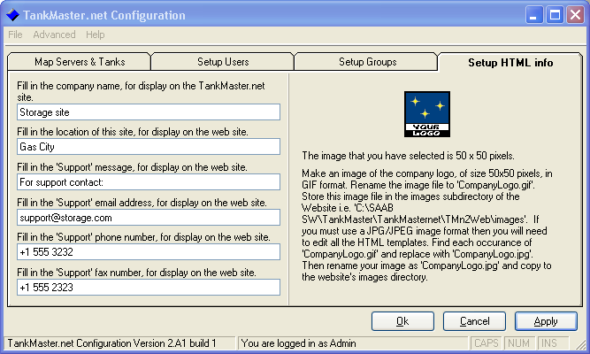
TMN Config
Setup HTML info
Wep page information

Slide 13
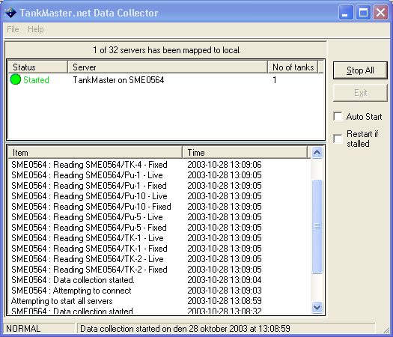

TMN Data Collector
Collects data from TankServer to the “Web Page”.
Auto start after PC reeboot
Automatic restart if TankServer connection stalls
Communication Log
Minimized to SystemTray to prevent accidetal closing

Slide 14
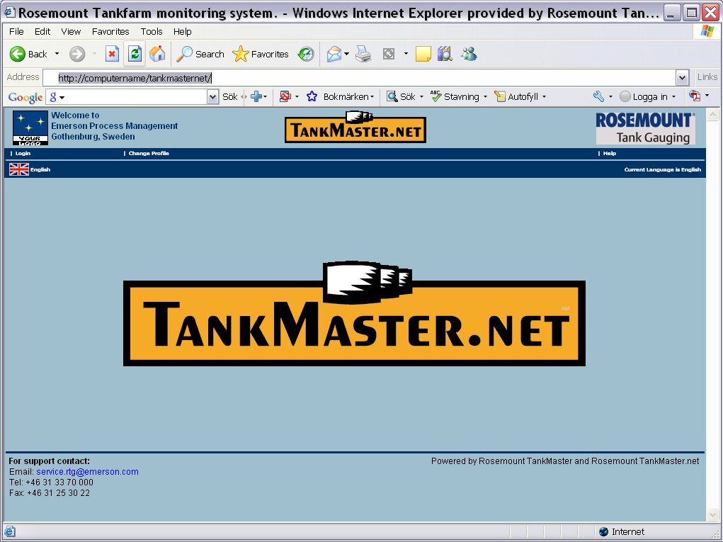
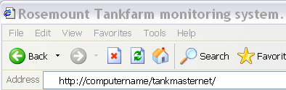
TankMaster.Net website

Slide 15
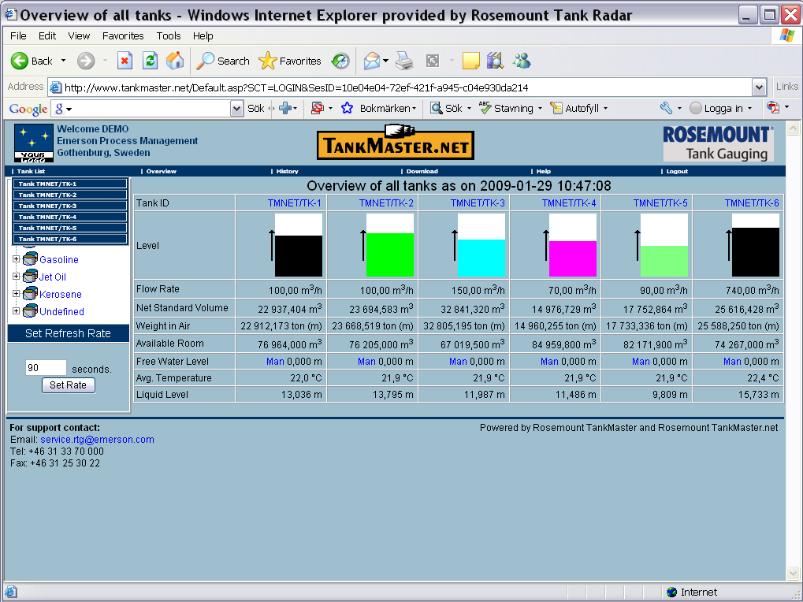
Overview of all tanks

Slide 16
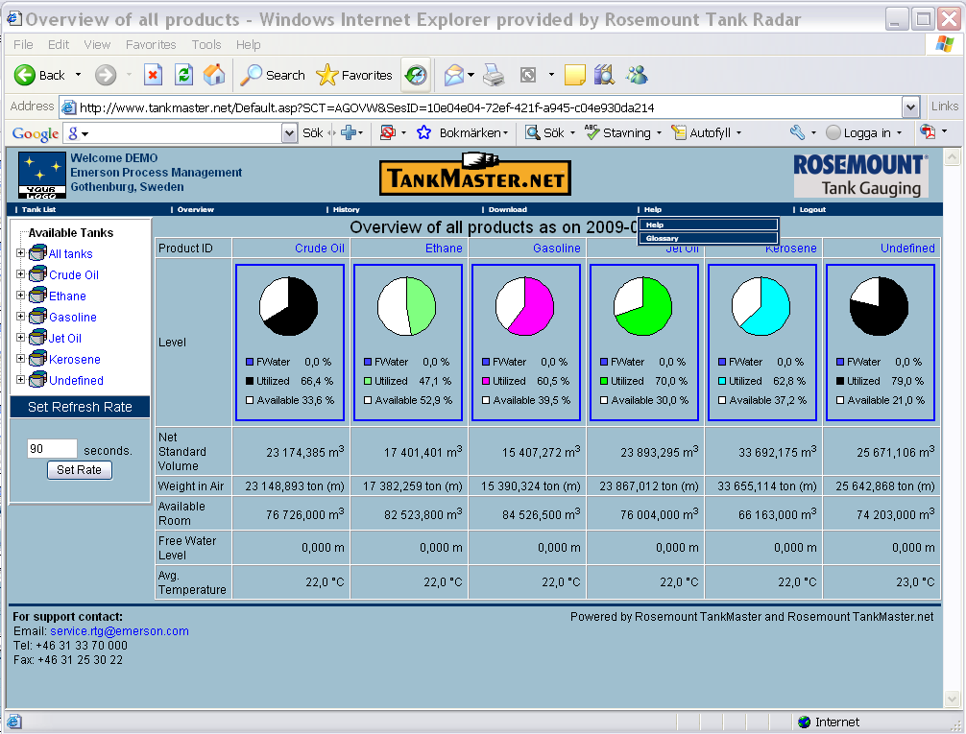
Overview of all products

Slide 17
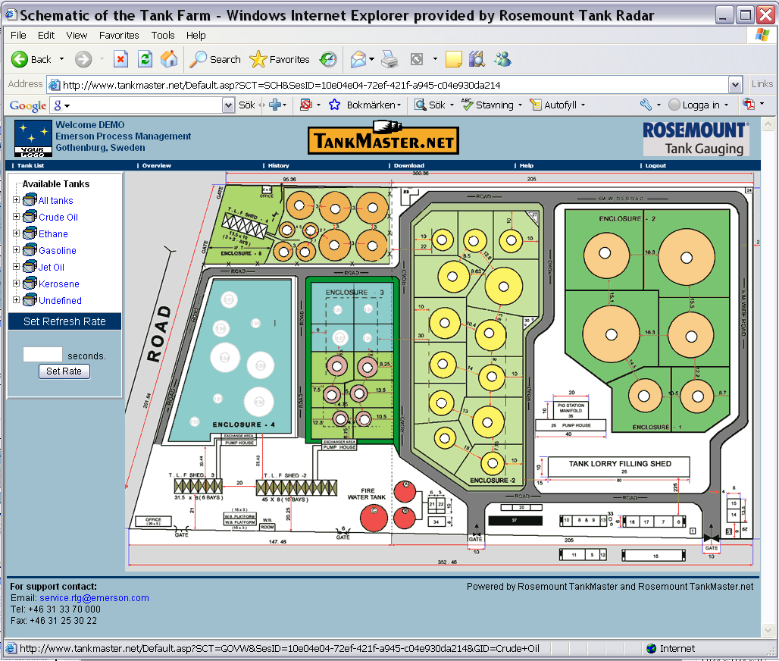
Overview - Schematic

Slide 18
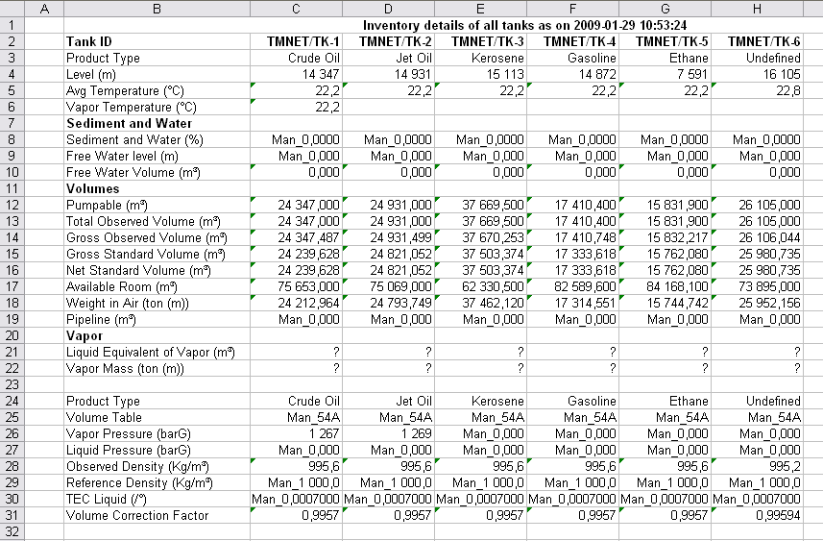
Download current data

Slide 19
Graph of all tanks
Notes:
OK, this is awesome!
-How do I put a system together??

Slide 20
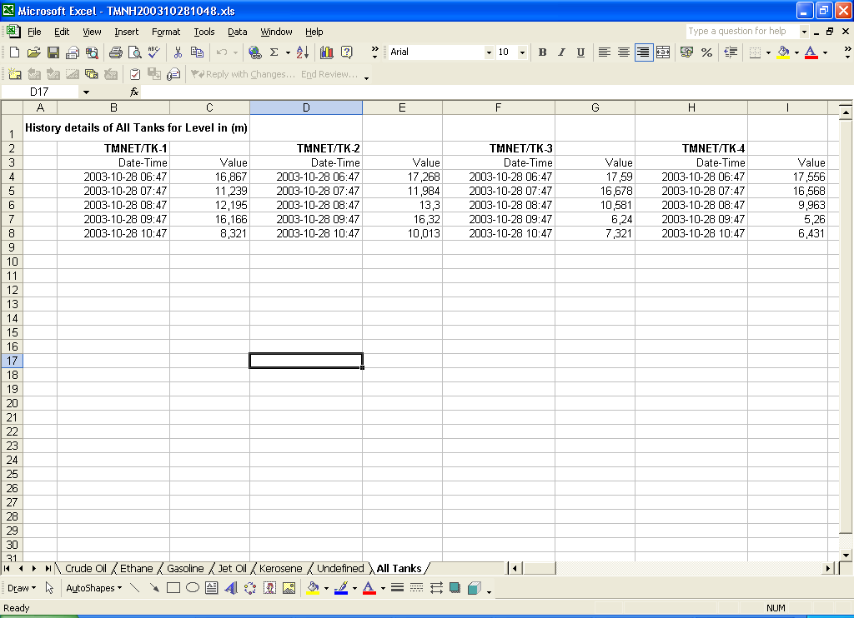

Slide 21
TankMaster.Net installation workflow
Client PC
Internet Explorer 5.x or later required
TM.net Server
Network
Standard Windows network LAN or WAN
Firewall and Gateway if connecting web server to Internet
Web server component
IIS (Internet Information Service) installed. Included in XP and 2000 Professionals.
Microsoft office installed on TM.Net server
Creating reports and graphs
TM.net license
Hardware key
Number of tankservers TM.net can connect to
Number of Web users that can be online simultaneous

Slide 22
TankMaster.Net installation workflow
Create an Windows Administrator account in TM.net Server
For example TMnAdmin
Note! Account have to have an password
Make sure microsoft office and ISS component is installed before installing TM.net
Install TankMaster.net
Configure directory security settings in webb server and DCOM settings
See TM.net installation manual
Start TMnet config
Map tankservers & tanks
Note! Tankserver have to be running in order for TM.net to find it
Create TM.net user accounts Start data collector
Verify web site

Slide 23
TankMaster.Net troubleshooting
Datacollector hang when started
Check if any mapped tank has been removed or renamed
Data collector hang when someone tries to download an excel file
Check if the windows user specified for the webb-server in directory security has a password
Error when trying to download excel sheet
Verify that no invalid characters are used in product name
No bargraphs is shown on web site
Check that all components in microsoft office has been installed
Bargraph are not scaled correct
Max volume in strapping table is used scaling of bargraphs
Wrong product color is shown
If a custom color is selected for a product this has to be specified in color.ini in TankMaster net folder (See TM.net manual)

Slide 24
TankMaster.net
References in world areas
Vopak, Brazil
PPMC, Ikeja, Nigeria (1:st of 6 terminals)
Pacific Terminals, Brisbane, Australia (1:st of 4)
IMC Terminal, Mumbay, India
Statoil, Göteborg, Sweden ( 1:st of 7 installations)
FIMA Bulking, Malaysia
Shell, Singapore
Bencom, Azores

Slide 25

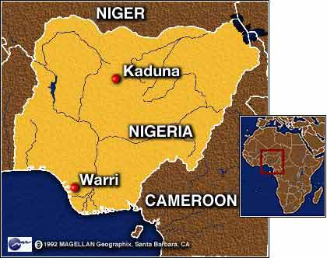
TankMaster.net
PPMC Nigeria, self installed TM.net
“Very easy to install by my self”
“Kudos” to the Development Team !

